Slide 1
Lecture 32: Turing Machine Variants
Agenda:
Turing Machine Variant
Turing Machine Example
Presented by
Prof. Vaibhav Narayan Chunekar
K. J. Somaiya College of Engineering, Vidyavihar, Mumbai

Slide 2
1.Multiple track Turing Machine:
A k-tack Turing machine(for some k>0) has k-tracks and one R/W head that reads and writes all of them one by one.
A k-track Turing Machine can be simulated by a single track Turing machine

Slide 3
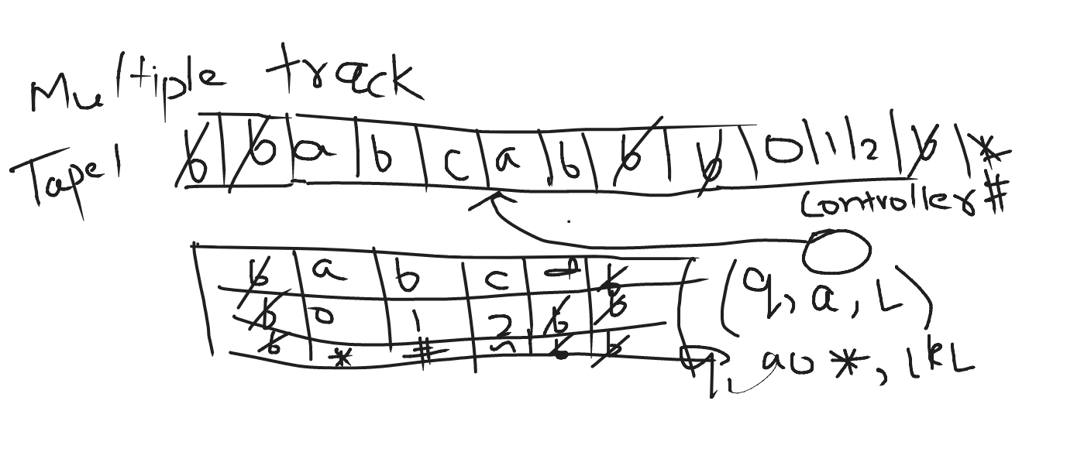
Multiple Track

Slide 4
2. Two-way infinite Tape Turing Machine:
Infinite tape of two-way infinite tape Turing machine is unbounded in both directions left and right.
Two-way infinite tape Turing machine can be simulated by one-way infinite Turing machine(standard Turing machine).

Slide 5
3.Multi-tape Turing Machine:
It has multiple tapes and controlled by a single head.
The Multi-tape Turing machine is different from k-track Turing machine but expressive power is same.
Multi-tape Turing machine can be simulated by single-tape Turing machine.

Slide 6
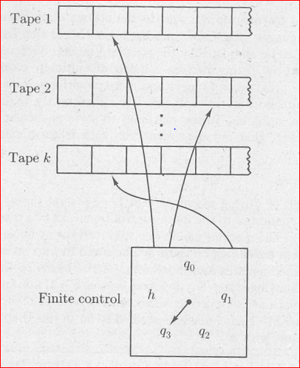
Multi-tape Turing Machine

Slide 7
4. Multi-tape Multi-head Turing Machine:
The multi-tape Turing machine has multiple tapes and multiple heads
Each tape controlled by separate head
Multi-Tape Multi-head Turing machine can be simulated by standard Turing machine.

Slide 8
5. Multi-dimensional Tape Turing Machine:
It has multi-dimensional tape where head can move any direction that is left, right, up or down.
Multi dimensional tape Turing machine can be simulated by one-dimensional Turing machine

Slide 9
6. Multi-head Turing Machine:
A multi-head Turing machine contain two or more heads to read the symbols on the same tape.
In one step all the heads sense the scanned symbols and move or write independently.
Multi-head Turing machine can be simulated by single head Turing machine.

Slide 10
7. Non-deterministic Turing Machine:
A non-deterministic Turing machine has a single, one way infinite tape.
For a given state and input symbol has atleast one choice to move (finite number of choices for the next move), each choice several choices of path that it might follow for a given input string.
A non-deterministic Turing machine is equivalent to deterministic Turing machine.

Slide 11
Construct a Turing Machine for language L = {0^{n}1^{n}2^{n} | n≥1}
The language L = {0^{n}1^{n}2^{n} | n≥1} represents a kind of language where we use only 3 character, i.e., 0, 1 and 2. In the beginning language has some number of 0’s followed by equal number of 1’s and then followed by equal number of 2’s. Any such string which falls in this category will be accepted by this language. The beginning and end of string is marked by $ sign.

Slide 12
Example:
Input: 001122
Output: Accepted
Input:0001122222
Output: Rejected

Slide 13
Approach:
Assumption: We will replace 0 by X, 1 by Y and 2 by Z
First replace a 0 from front by X, then keep moving right till you find a 1 and replace this 1 by Y. Again, keep moving right till you find a 2, replace it by Z and move left. Now keep moving left till you find a X. When you find it, move a right, then follow the same procedure as above.
A condition comes when you find a X immediately followed by a Y. At this point we keep moving right and keep on checking that all 1’s and 2’s have been converted to Y and Z. If not then string is not accepted. If we reach $ then string is accepted.

Slide 14
Construction Steps:
Step-1: Replace 0 by X and move right, Go to state Q1.
Step-2: Replace 0 by 0 and move right, Remain on same state Replace Y by Y and move right, Remain on same state Replace 1 by Y and move right, go to state Q2.
Step-3: Replace 1 by 1 and move right, Remain on same state Replace Z by Z and move right, Remain on same state Replace 2 by Z and move right, go to state Q3.

Slide 15
Construction Steps:
Step-4: Replace 1 by 1 and move left, Remain on same state Replace 0 by 0 and move left, Remain on same state Replace Z by Z and move left, Remain on same state Replace Y by Y and move left, Remain on same state Replace X by X and move right, go to state Q0.
Step-5: If symbol is Y replace it by Y and move right and Go to state Q4 Else go to step 1
Step-6: Replace Z by Z and move right, Remain on same state Replace Y by Y and move right, Remain on same state If symbol is $ replace it by $ and move left, STRING IS ACCEPTED, GO TO FINAL STATE Q5

Slide 16
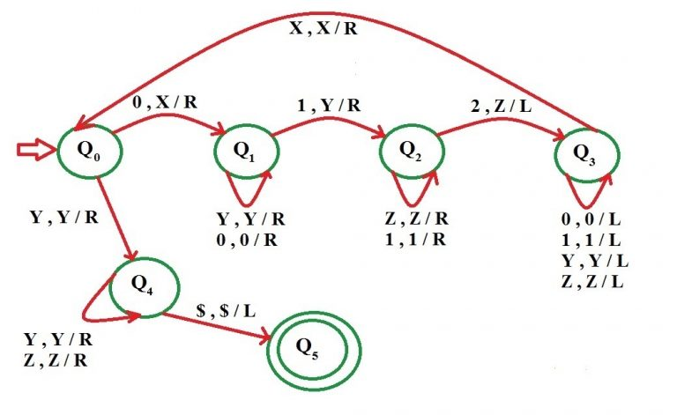
Construction a Turing Machine for language L = {0^{n}1^{n}2^{n} | n≥1}

Slide 17
Thanks !!!

